Slide 1
Inventory Management
Quick rundown of database topography, types, and functionality

Slide 2
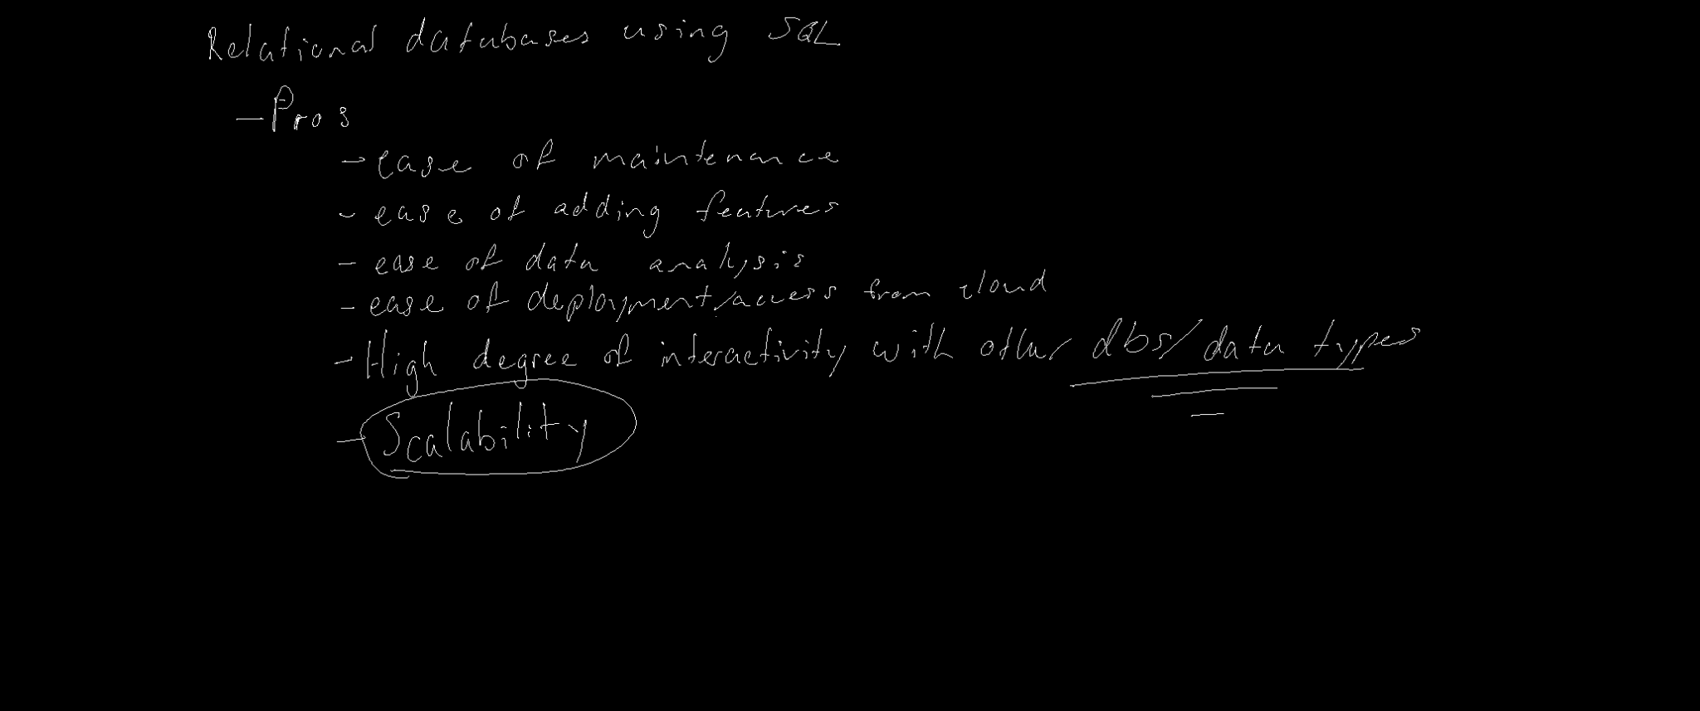

Slide 3
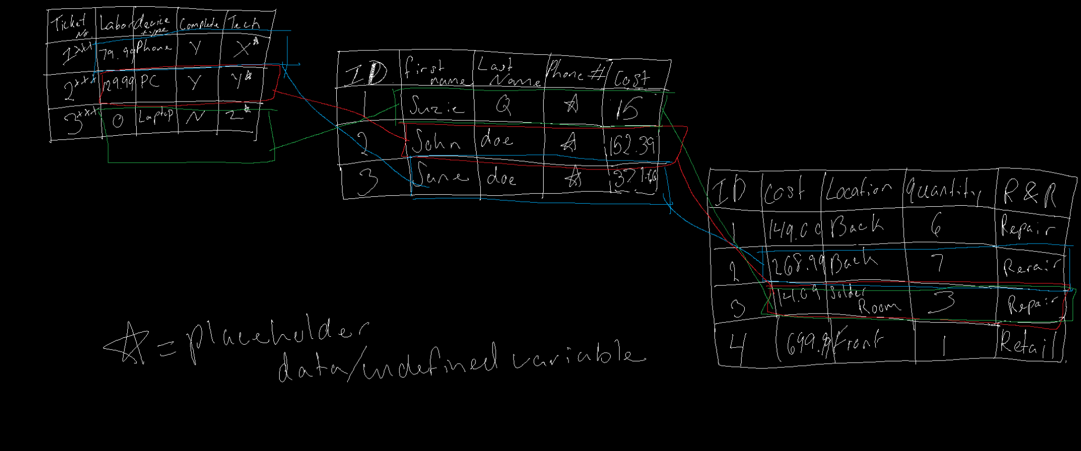

Slide 4
